Slide 1
Introduction:
My name is Hamza Jadoon and my groups members are Afnan Tariq ,Aaliyan Shujah and Abdul Ahad.
First my group members and me tried to contact different industries but they rejected us almost 4 to 5 time after that we got an approval from an industry in Hattar. We visited a plywood industry (AA PLYWOOD INDUSTRY) in Hattar. They tell us about the full procedure, machinery they are using, safety precautions they are using and also the material.

Slide 2
Objectives:
Main objective of this project is to get practical knowledge of how manufacturing processes are performed in the industries .
To get students familiar with the manufacturing industries by visiting these industries to get practical experience .

Slide 3
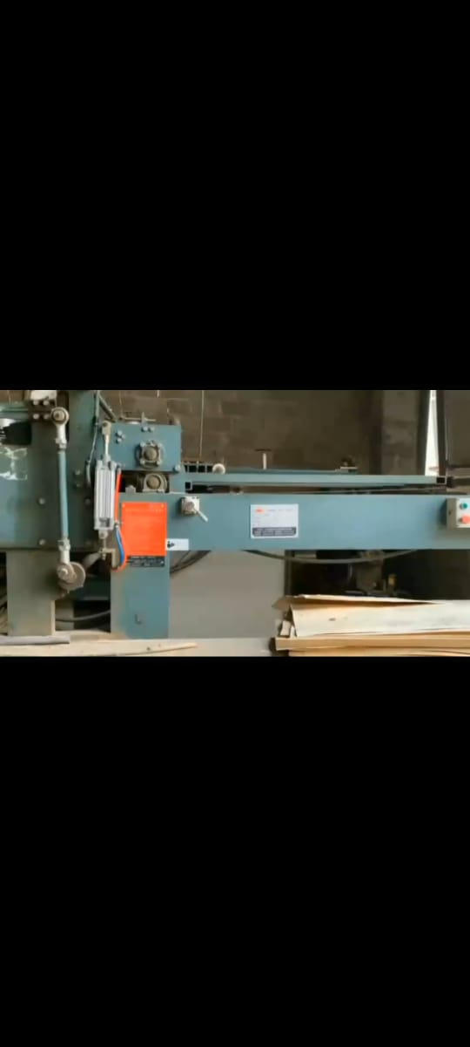
Process:
First they use a pilling machine to cut down the wood.

Slide 4
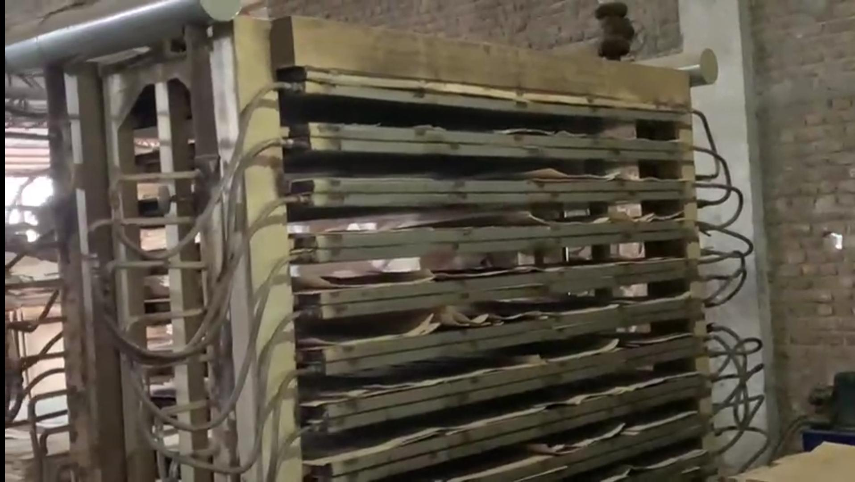
Than the straight Pieces of wood are placed in open area for sundry.
Then those pieces are put into the dryer for further drying.

Slide 5
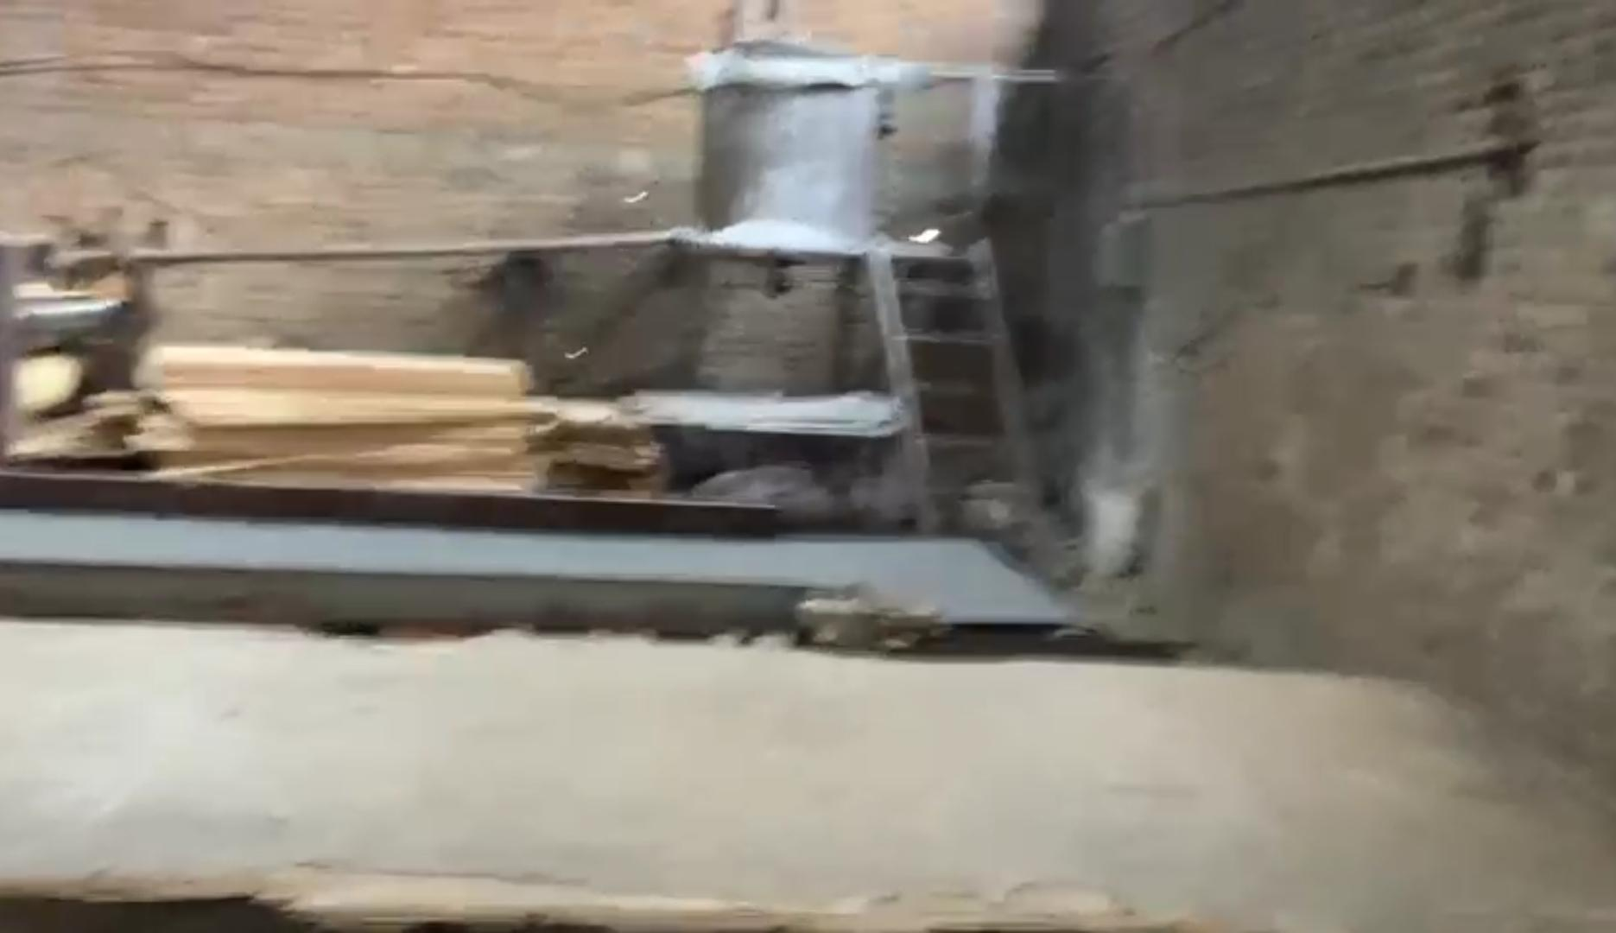
Then those pieces are put into a machine (known as production line) to give them a shape of sheets and also apply glue on them and then put a dry sheet on it.

Slide 6
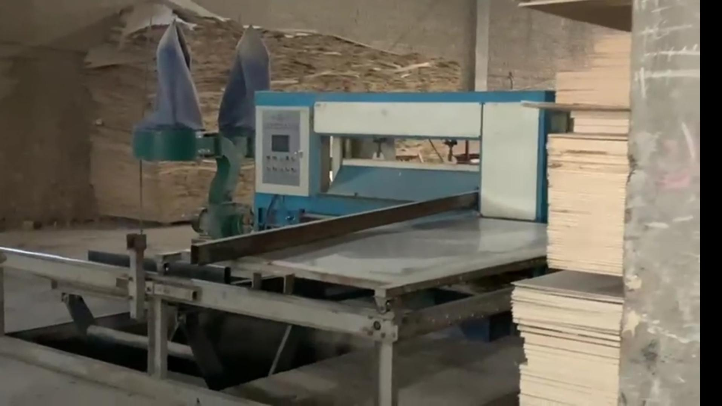
Then they put them into a machine for cool press. Its main purpose is to reduce the cycle time that is needed in case of hot press and thus make the plywood better in terms of quality after it gets glued.
Then they put it into hard press and also paste a paper on it.
Then those sheets are sent to sawmill for proper cutting.
Then they paint the edges and give them a finishing touch

Slide 7
Workers:
There are almost 70 to 80 workers in that industry which includes some local that go there home daily, workers of the same city they go to their home once in a week and some are from other cities who go to home once of twice in a month.

Slide 8
Worker rights:
They take care of their employees, their rights and their help as well. Work time is 7 hours (8am to 3pm) and has 1 holiday a week. They also take care of the health of their employees and built a masjid just near to their industry.

Slide 9
Effects on Environment:
The machinery that they were using produces a large amount air as well as sound pollution.
A large amount of scrap is produce during this process.
They provide that scrap to the local public for their works so that also produce air pollution.

Slide 10
Ethical Dilemmas:
The wood that they are using for their industry came from Punjab. They even think its bad for environment.
They are using large amount of timber especially Eucalyptus (safeda).

Slide 11
Chances of disaster:
Any kind of mistake may cause a huge disaster. Like it set a fire to the whole building even can catch the surrounding in the fire. Many people can be die or can be seriously injure.

Slide 12
Roll of Engineers:
The basic roll of engineer is to make the machine that are safe to use and produce no or very low air and sound pollution.
They should make a system that they if you cut one tree you must plant other in order to maintain the equilibrium in the environment.

Slide 13
Workplace responsibilities:

Slide 14
ENVIRONMENTAL HAZARDS:

Slide 15
SAFETY PRECAUTIONS:

Slide 16
Employee salaries:

Slide 17
ALTERNATIVE SOLUTION OF ANY MISSHAP

Slide 18
MORAL AND ETHICS:

Slide 19
DISCUSSION MAKING

